Slide 1
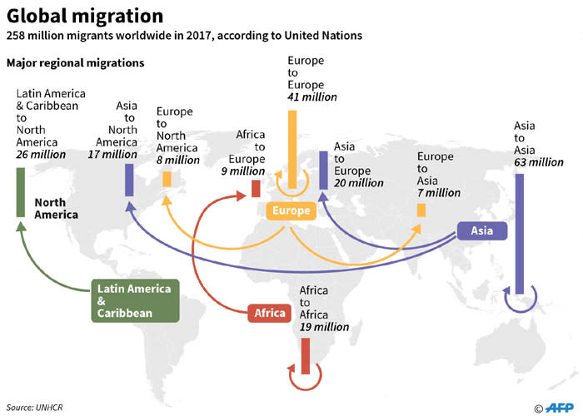
Figure 1
Major Global Migration Statistics by Region
( United Nations, 2017)

Slide 2
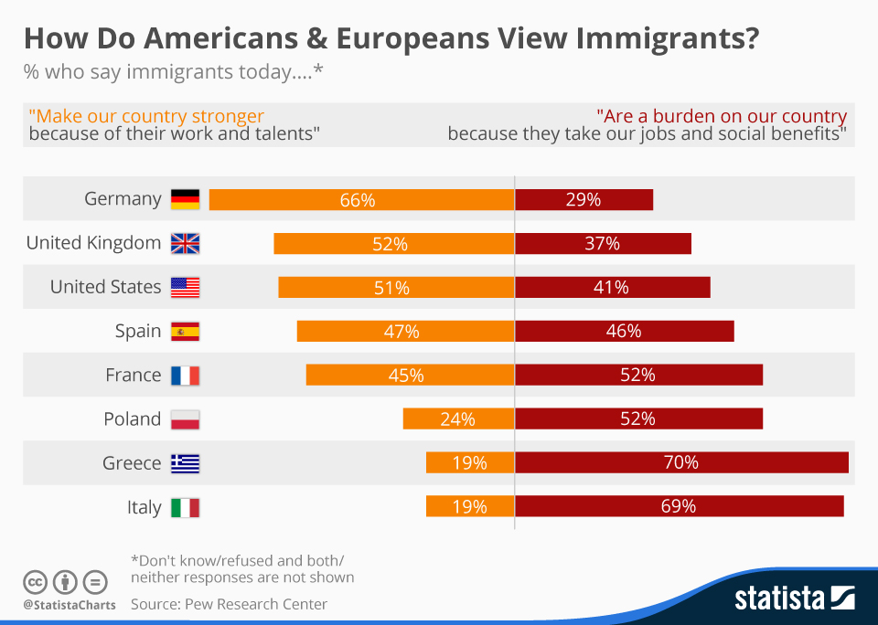
Figure 2
View of Immigrants by Europeans and Americans
(Pew Research Center, 2015)

